Slide 1
Basis of Polymorphism (Ingredients)
Inheritance
Method overriding
Polymorphic assignment // SuperClassVariable = SubclassObject;
Polymorphic methods
In Java, all methods are polymorphic.
That is, choice of method depends on the object.

Slide 2
Example: Polymorphism
Furniture
abstract class Furniture {
public int numlegs;
}
abstract class Chair extends Furniture {
public String fabric;
abstract void prnt();
}
class Recliner extends Chair {
void prnt() {
System.out.println(“I’m a recliner”);
}
}
class LaZBoy extends Recliner {
void prnt() {
System.out.println(“I’m a lazboy”);
}
}
Chair
void prnt();
Recliner
void prnt();
LaZBoy
void prnt();
What is the output?
Chair cha;
cha = new LaZBoy();
cha.prnt();
Furniture furn;
furn = new Recliner();
furn.prnt();
Furniture furn;
furn = new LaZBoy();
furn.prnt();

Slide 3
More Examples
Speaker guest;
guest = new Philosopher();
guest.speak();
guest = Dog();
guest.speak();
public interface Speaker
{
public void speak();
}
class Philosopher extends Human implements Speaker
{
//
public void speak() {…}
public void pontificate()
{…}
}
class Dog extends Animal implements Speaker
{
//
public void speak() {
…
}
}
Speaker special;
special = new Philosopher();
special.pontificate();
// compiler error
Speaker special;
special = new Philosopher();
((Philosopher)special).pontificate();

Slide 4
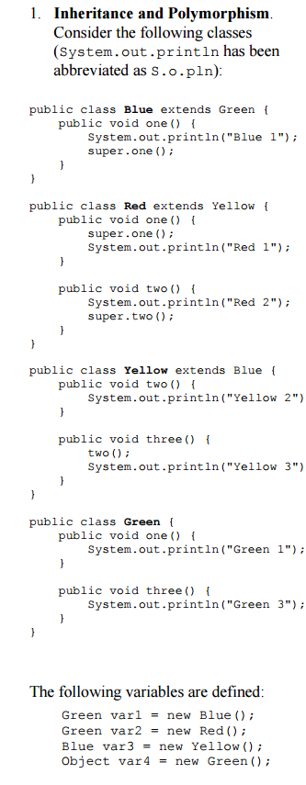
Example: Prelab
Green
one/three
Blue
one
Yellow
two/three
Red
one/two
What is the output?
var2.three();
Red 2/Yellow 2/Yellow 3

Slide 5
Interfaces and Polymorphism
Apparent type = What does it look like at a particular place in program (changes).
Determines: What methods may be invoked
Actual type = What was it created from (never changes)
Determines: Which implementation to call when the method is invoked

